Slide 1
Local Development to CI/CD
Autumn 2023
Frederic Wagner & Ed Moore
Technical Solutions Specialist, Customer Success Specialist

Slide 2
Agenda
Section 1: Introduction to Automation
Automation Concepts – 5 mins
IaC (Infrastructure as Code) – 10 mins
CI/CD (Continuous Integration & Continuous Delivery) – 5 mins
Demo: Manual vs Automated – 30 mins
Manual changes vs Automated
Section 1: Introduction to Automation
Automation Concepts
Infrastructure as Code
CI/CD
Notes:
- Typical Use Cases/Personas - Lab Topology - basic setup/connectivity - CICD - Why we need it - What it does and how it helps - IaC - CLI Migration - CLI to tools/processes and job retention - Config formats - specific syntax to generic data and templates - Standardised processes - governance, triggers

Slide 3
Back to Basics
Let’s talk IT & Cloud Automation
Automating Business Processes
Automating Workloads
IT automation functions at the business level. Orchestrate processes across various business areas, environments, APIs & instances
Automating Workflows
IT process automation across platforms and applications expand
the capacity & control of IT operations
Automating Tasks
Generally involving the completion of a series of related IT tasks
Manual
Automate an IT task. A task, put plainly, is one technology-related action
A Human process
System complexity and value, both increase as we climb the Automation mountain but value is limited by external factors.
Notes:
So after speaking to many customers , we generally see them fitting into one of the 5 buckets illustrated above
Give example for eachone. Manual Example: Copy static config from a notepad template into a router via CLIb
Automating Tasks Example: Creation of a user account in an operating system
Automating Workflows : a script to validate current operating systems installed on the network
Automating workloads Example: monitoring a shared drive for utilization. Once a certain % threshold hits (trigger), additional storage is automatically added. This is done via an event trigger that is completed in real-time, rather than according to a time-based schedule
Automating Business Processes Example: business process management, powered by IT automation:
Automatic assignment of access to certain services & usage levels based on customer account level or region.
Provisioning of computers, mobile devices, and software for onboarding new employees.
So an open Question to the group where so you think you fit in this infographic ?

Slide 4







Automation Strategy
Organisations have similar themes but often unique priorities and challenges. Generally, the approach is dependent on whether we’re adopting a tactical technical solution or strategic organisational transformation.
Resource Availability
Security Requirements
Time to Value
User Competency
Technical Complexity
Technical Debt
Notes:
Presenter:
Strategy is going to be largely dependant on your organisation but what we can do today are describe what some of the impacting factors are:
Resource Availability – Do you have people required to work on your programme/initiative?
User Competency – What level of competence do your users and implementers have? How does this influence the in-house vs COTS decision making?
Security Requirements – Are you restricted by the services you can provision and the tools you use to satisfy your requirements? Are there data requirements that limit how you can store configuration for example?
Technical Complexity – What is it you’re trying to achieve? Is your scope large enough that you should invest in organisational change or small enough that a few people can solve the problem?
Time to value – When do you need to see results? Your strategy could be to deliver results next week or next year depending on the other factors but is there a hard date or factor to consider?
Technical debt – How much non-standardisation and legacy artefacts are you having to drag along?
It’s important to take the above factors into consideration otherwise you run the risk of some seriously unsatisfied stakeholders – worse case is that poor planning/execution leads to corner cutting and then poor adoption by the end users. Ultimately it impacts everyone.

Slide 5
Automation & Orchestration Use Cases
Visibility
Data Aggregation
Network Visibility
Event Correlation*
Automation
Configuration Management
Infrastructure as Code
Network Provisioning
Policy Management
Closed Loop Automation
Service Orchestration
Automation
Delivery
Automation
Testing
SRE / DevOps Model
CI/CD
Business and IT Alignment
In-house expertise
Tool Consolidation
Automated Testing
Issue Resolution
Compliance/Assurance Testing
Pre/Post Change Validation
Event Correlation*
Notes:
Presenter:
For the purposes of the ATX we’ve separated defined Automation use-cases into four categories:
Visibility – How can we see what our Infrastructure is doing and ideally correlate across diverse endpoints. There is a broader area Cisco is focusing on called ‘Full Stack Observability’ that includes several of these areas but for this case we’re just focusing on how do we see what our Infrastructure is doing.
Automation – How do we transform manual processes into repeatable, simple and safe tasks that provide more business value? This is the primary driver for IaC
Delivery Automation – How do we ensure that the people and components in these functions work the most effectively?
Testing – How can we ensure that the intent of our actions give us the outcome we need and ensure high level’s of reliability.

Slide 6
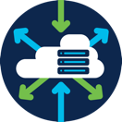

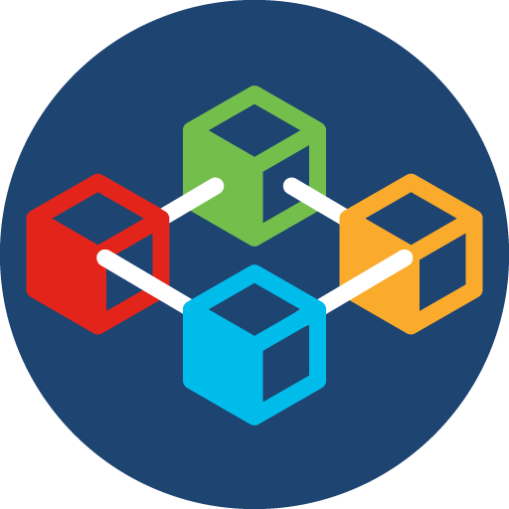

General Themes: Infra as Code
Device Abstraction
Service Modelling
Release Pipelines
Infrastructure as Code (IaC) is a key DevOps principle where infrastructure is managed and provisioned in a repeatable, deterministic way. Environment drift is negated through approved release pipelines, that enforce global policies, to ensure compliance and standardization.
Notes:
Presenter:
To start with – what is Infra as code? If you speak to different people, you tend to get different answers and that’s ok because it provides different benefits and headaches depending on your role. For this presentation we’re going to define Infra as Code as : “Infrastructure as Code (IaC) is a key DevOps principle where infrastructure is managed and provisioned in a repeatable, deterministic way. Environment drift is negated through approved release pipelines, that enforce global policies, to ensure compliance and standardization. “
So what does that mean? In simple terms the main issue we’re looking to avoid are slow, complicated processes that result in painful change management and stagnation.
Device Abstraction – Is the process of separating the configuration/state from a device to a source-controlled description that provides all the information required to rebuild the infrastructure. There are many ways to structure this including device-specific templates, role-specific templates, golden configs, service descriptions and geographical templates but in essence we’re taking the individual configurations and making them structured and repeatable. A good example of this is when we want to change the address for a NTP server across our estate, in traditional networking you need to log in to every device, with IaC you change it in one place and that should cascade down to all users of that NTP server.
Service Modelling – This is an interesting topic that we could spend hours on but in essence we’re looking to describe each service that is provisioned on our infrastructure, an example of a service could be ‘DNS or O365 or Webex’ .Most of us would have logged in to a box at some stage with 1000 lines of ACLs restricting and permitting specific endpoints – service modelling aims to simplify this complexity by describing a particular service requirements which can then be used to provision a device, this is particularly useful when we consider the lifecycle of an application from provisioning, update, expansion and retirement. In practice we can do this using tools like NSO to manage the service lifecycle but there are more basic approaches as well that fulfill a subset of use cases in this area.
Release Pipelines – Encompass all the steps required to transition from a change to the configuration (model, template, variable) to the actual change in production. These steps could all be automated or a subset of manual and automated changes. If you aren’t familiar with automation, you can imagine all the activities required to make a change in your environment from request, approval, test, implement, operate. It is the goal of Automation as a whole to automate everything, in practice this is difficult to achieve so you may find that even if you’ve got an IaC setup there are manual processes still in that chain. Examples of release pipelines could be something like:
User updates interface description within git and commit’s change
Change is tested for syntax issues and linted
Change is tested in lab against virtual or physical devices
Report is issued to stakeholders
Change is approved in Webex teams
Interface is updated using an Ansible module for the device
Users are updating with positive change results
To summarize Infrastructure as code is a collection of principles designed to simplify our environments and allow us to change more rapidly.

Slide 7

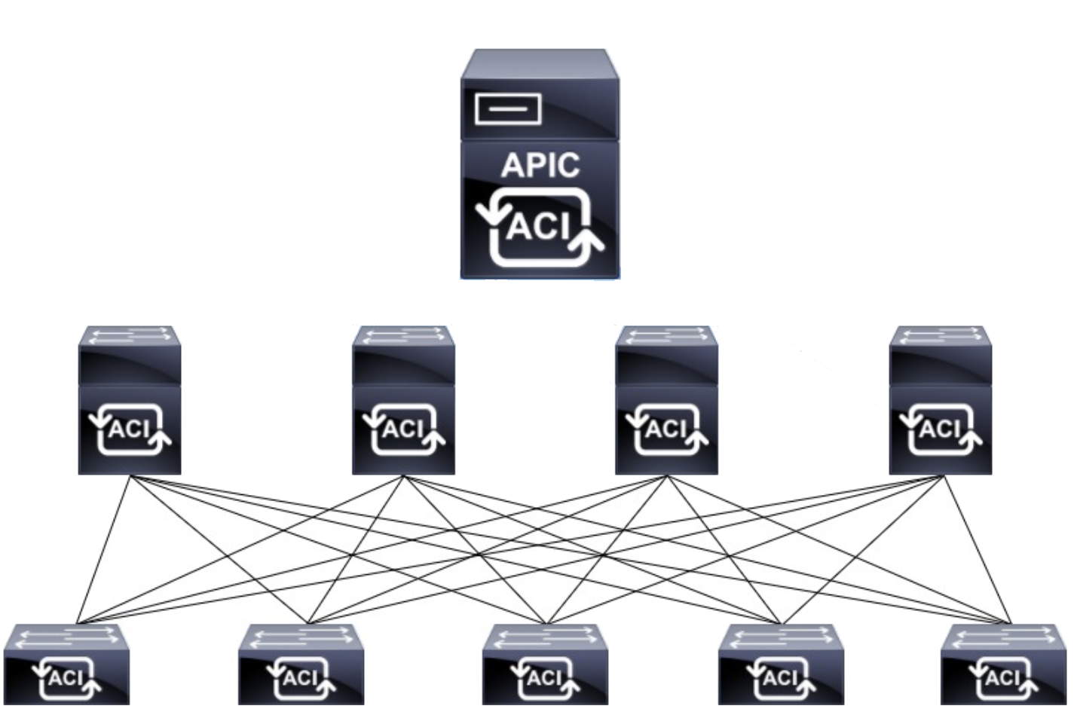



Manual Driven Configuration
Business
requirements
Network Engineer
APIC Network Controller
ACI Network Infrastructure
Clicks
GUI
Manage
Lots of clicks
GUI
GUI
GUI
GUI
Manage
Infrastructure
Config Intent “database”
CLI
CLI
CLI
CLI

Slide 8
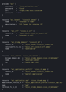

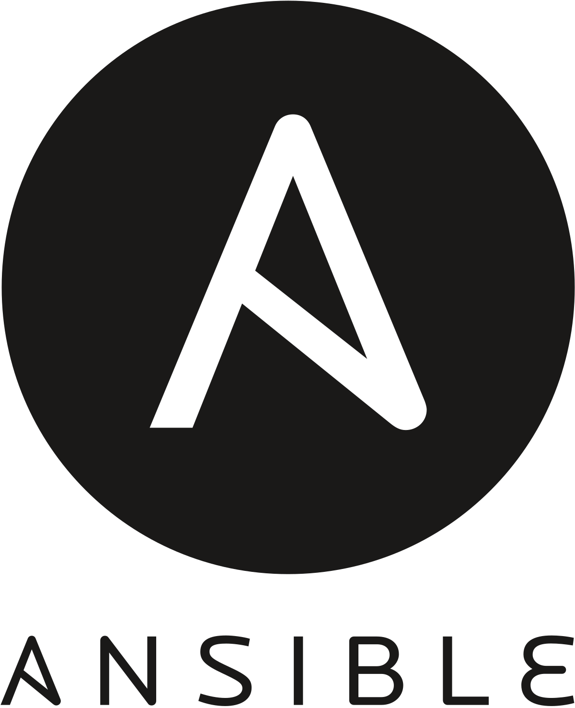
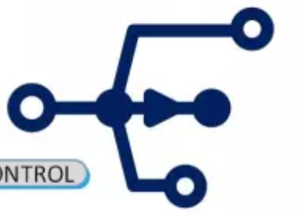
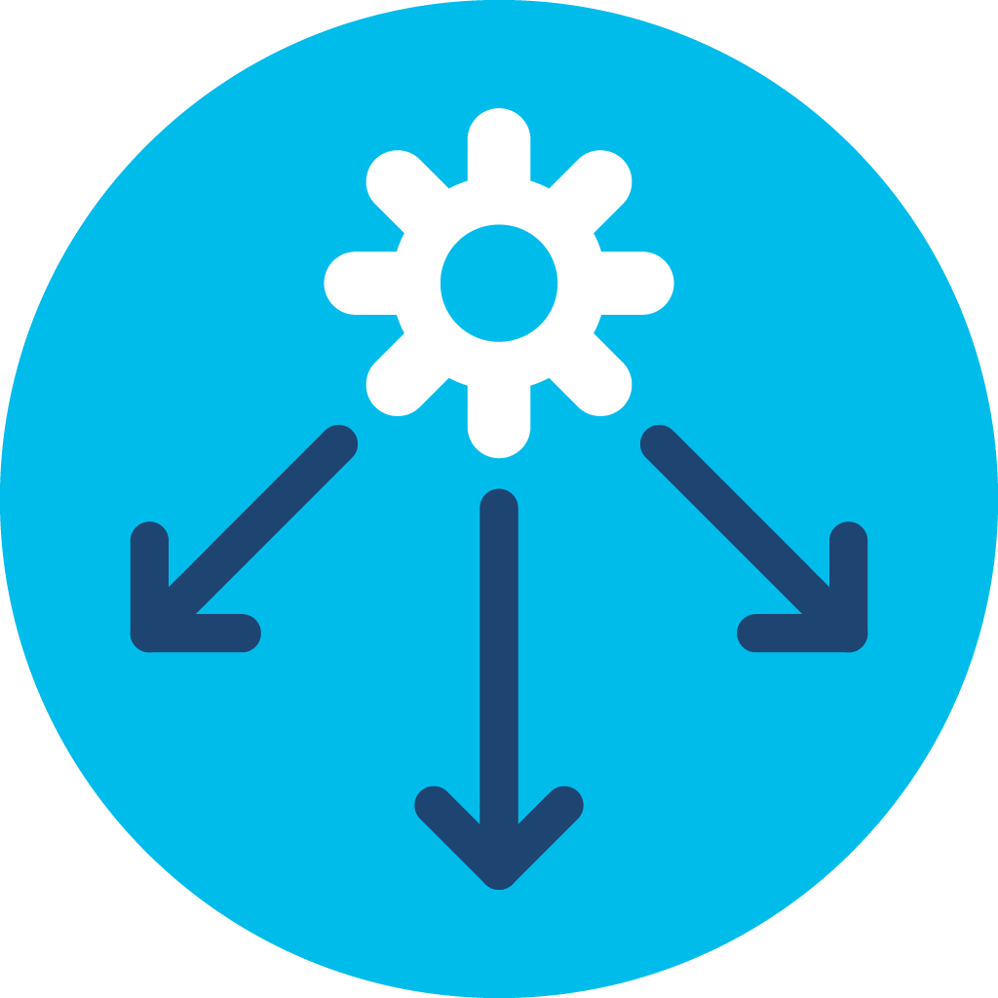
Model Driven – Infrastructure as Code
Business
requirements
Network Engineer
Network Model IaC definitions
IaC tools
APIC Network Controller
ACI Network Infrastructure
Manage
API
Version Control
System
Pipeline

Slide 9




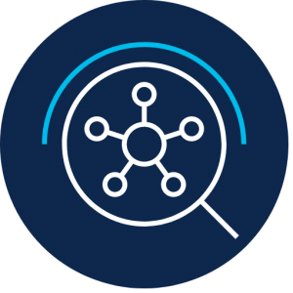
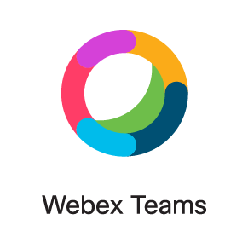



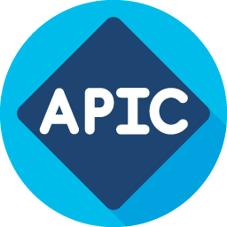
ACI with CI/CD Integration using Terraform
Key Take Away – Everything is tested and validated before it’s pushed to the live environment
GIT push to feature branch
Jenkins triggers pipeline
Input validation and linting
Terraform
Plan
NDI Pre-Change Analysis
Webex Teams notification
Pre-Production Platform
Production Platform
Operator
GIT merge to master branch
Webex Teams notification
Run NDI Delta Analysis
Testing
Terraform Apply
Jenkins triggers pipeline
Store test reports as Artifacts
Infrastructure

Slide 10
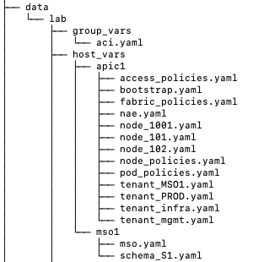
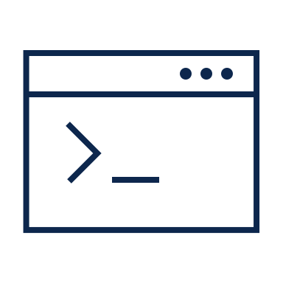
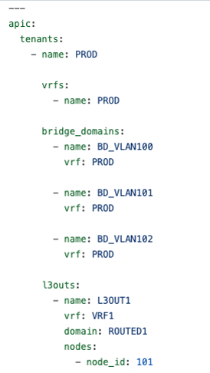
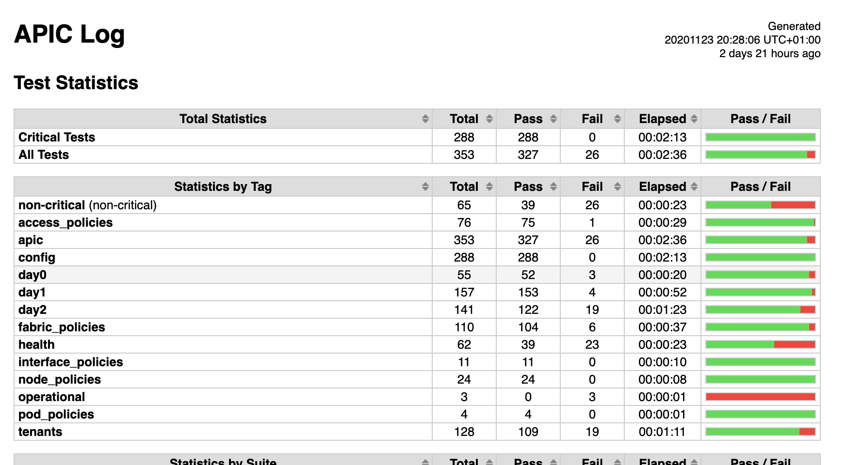
What does this look like?
iac-test does not include operational testing, that is addressed as part of the CAIT offer.
Configuration
Pre-Deployment Validation
iac-validate
Rule 101: Verify unique keys ['apic.node_policies.’]
Rule 205: Verify Access Spine Interface Policy Group references [‘apic.interface_policies.nodes.interfaces.policy_group – SERVER1']
Automated Testing
iac-test
……

Slide 11
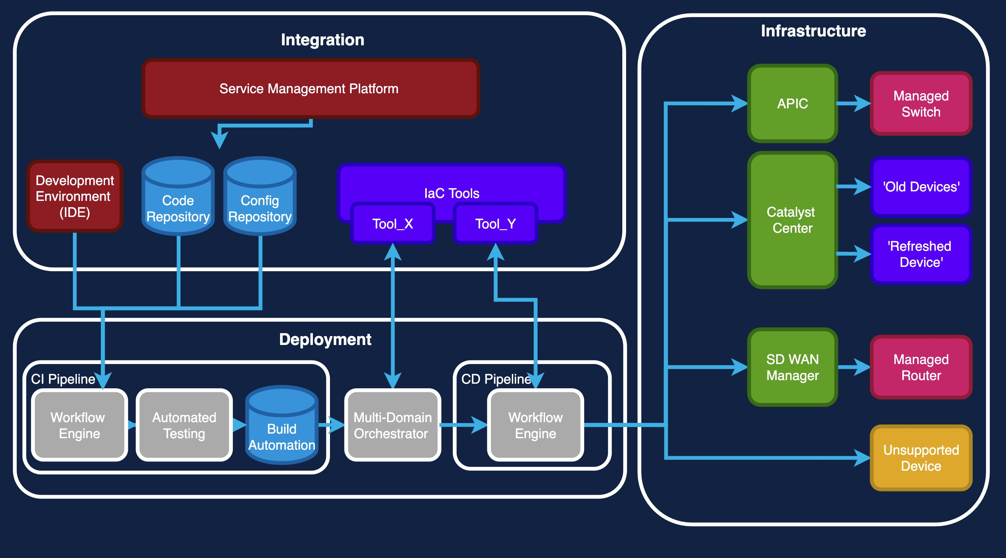
Example Architecture
Simplicity
Focus on standardization of platforms, tools and processes
Acceleration
Focus is how to drive value as quickly as possible, strategic decisions focus on whether to consume or create logic with native vs open source.
Efficiency
Initial focus should be on reducing effort or risk i.e. ‘how you make a change.’
As capabilities grow the goal should be to maximize value with Cross-Domain workflows and monitoring.

Slide 12
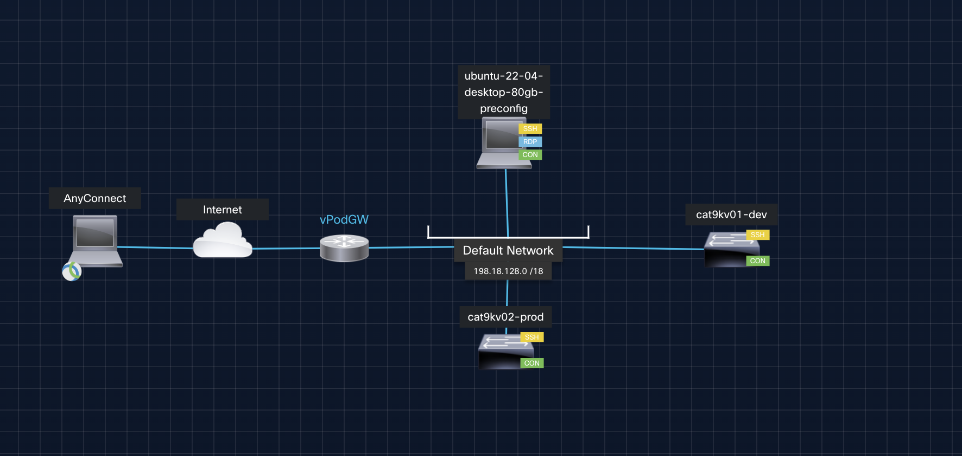
Demo 1 : Agenda & Outcomes
Lab Guide
GitHub Repository
DevNet Learning Lab
Tasks: Hands on 1
Establish connectivity
Basic manual device change
Basic tool-based device change
Tasks: Hands on 2
Execute change via pipeline
Understand importance of standardisation
Understand components in classical CI/CD
Outcomes
Familiarity with Automation tools: Gitlab & Ansible
Basic understanding of containerization: Docker
Acceptance of potential value when compared with manual processes

Slide 13
Different Types of Testing
In the validation phase several tools are used to ensure that the provided input data is valid, but also that common best practices and formatting guidelines are followed.
Format validation – limits typos
Syntax validation –enforces standardization of variables
Semantic validation – enforces policy adherence
System testing - tests an entire system end-to-end

